Slide 1
Machine Learning

Slide 2
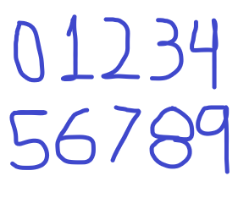
Machine Learning
Classify
0 | 1 | 2 | 3 | 4
5 | 6 | 7 | 8 | 9

Slide 3






Machine Learning
Preprocessed
(feature extraction)
Training set
Target vector
$$x=\left\{x_{1},…,x_{N}\right\}$$
$t$=4
Training or learning phase
Used to train the parameters of an adaptative model y(X).
$$y(X)$$
$$x=\left\{x_{1},…,x_{N}\right\}$$
$t$=4

Slide 4
Machine Learning
Classification
Assign each input vector to one of a finite set of categories
Supervised learning
The output consists of one or more continuous variables
Regression
Clustering
Discover groups of similar examples
Types of machine learning
Unsupervised learning
Density estimation
Determine the distribution of data within the input space
Visualization
Project the data form a high-dimensional space down to 2 or 3 dimensions
Reinforcement learning
Maximize a reward in some given situations

Slide 5
Classification
Assign each input vector to one of a finite number of discrete categories
Supervised learning
Regression
The output consists of one or more continuous variables
Clustering
Discover groups of similar examples
Unsupervised learning
Density estimation
Determine the distribution of data within the input space
Types of machine learning
Visualization
Project the data from a high-dimensional space down to 2D or 3D
Semi-supervised learning
Recognizes objects (unsupervised) then the user tags the objects (supervised)
Search
Reinforcement learning
Maximize a reward in some given situations
by finding a suitable action

Slide 6
Supervised learning
Unsupervised learning
Types of machine learning
Semi-supervised learning
Reinforcement learning

Slide 7
Classification
Assign each input vector to one of a finite number of discrete categories
Supervised learning
Regression
The output consists of one or more continuous variables
Unsupervised learning
Types of machine learning
Semi-supervised learning
Reinforcement learning

Slide 8
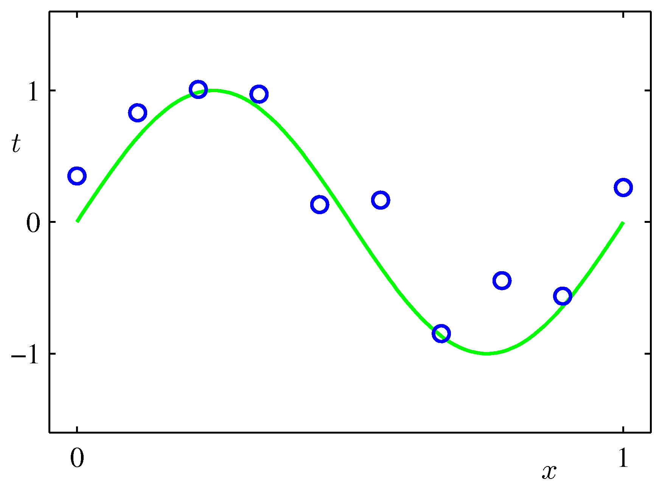
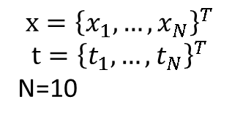
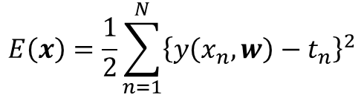
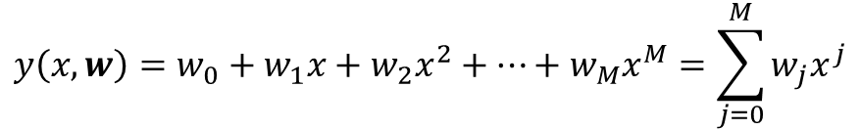

Toy Example
$$x={\left\{x_{1},…,x_{N}\right\}}^{T}$$
$$t={\left\{t_{1},…,t_{N}\right\}}^{T}$$
N=10
$$Sin(2 πx)$$
Using a linear model (linear in the parameters)
$$y\left(x,w\right)=w_{0}+w_{1}x+w_{2}x^{2}+…+w_{M}x^{M}=\sum_{j=0}^{M}{w_{j}x^{j}}$$
Minimizing as error function
$$E\left(x\right)=\frac{1}{2}\sum_{n=1}^{N}{{\left\{y\left(x_{n},w\right)−t_{n}\right\}}^{2}}$$

Slide 9
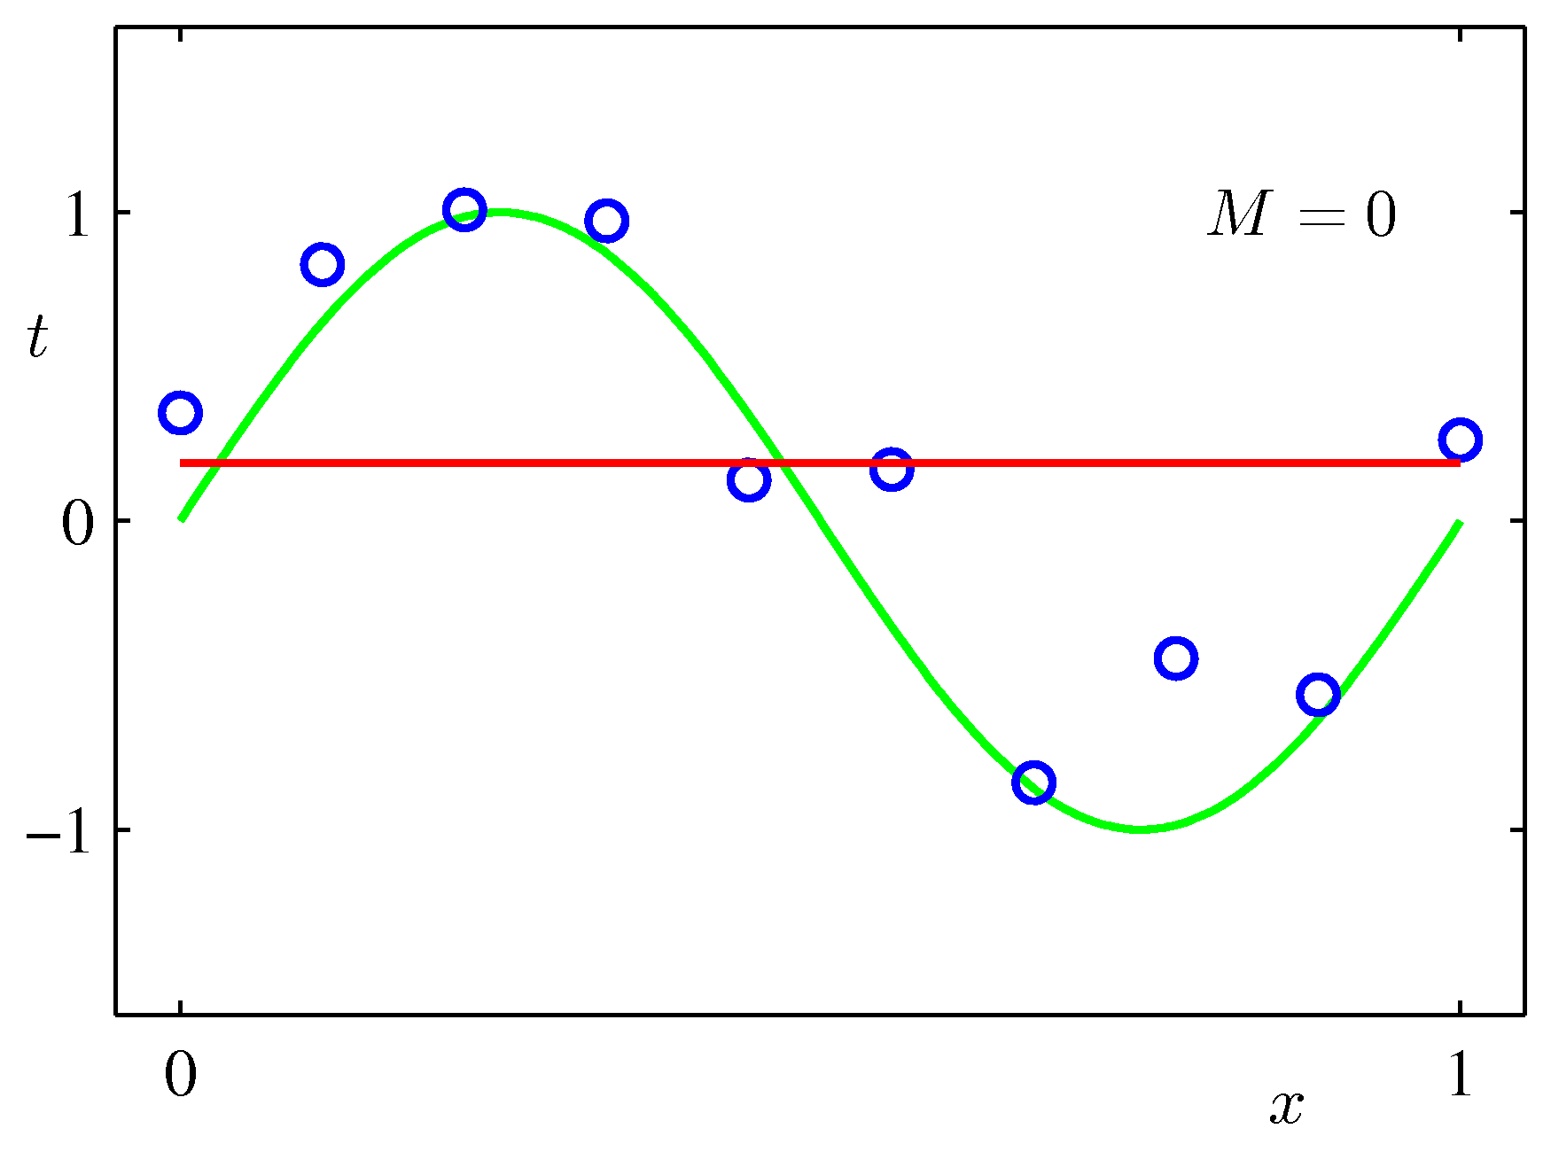
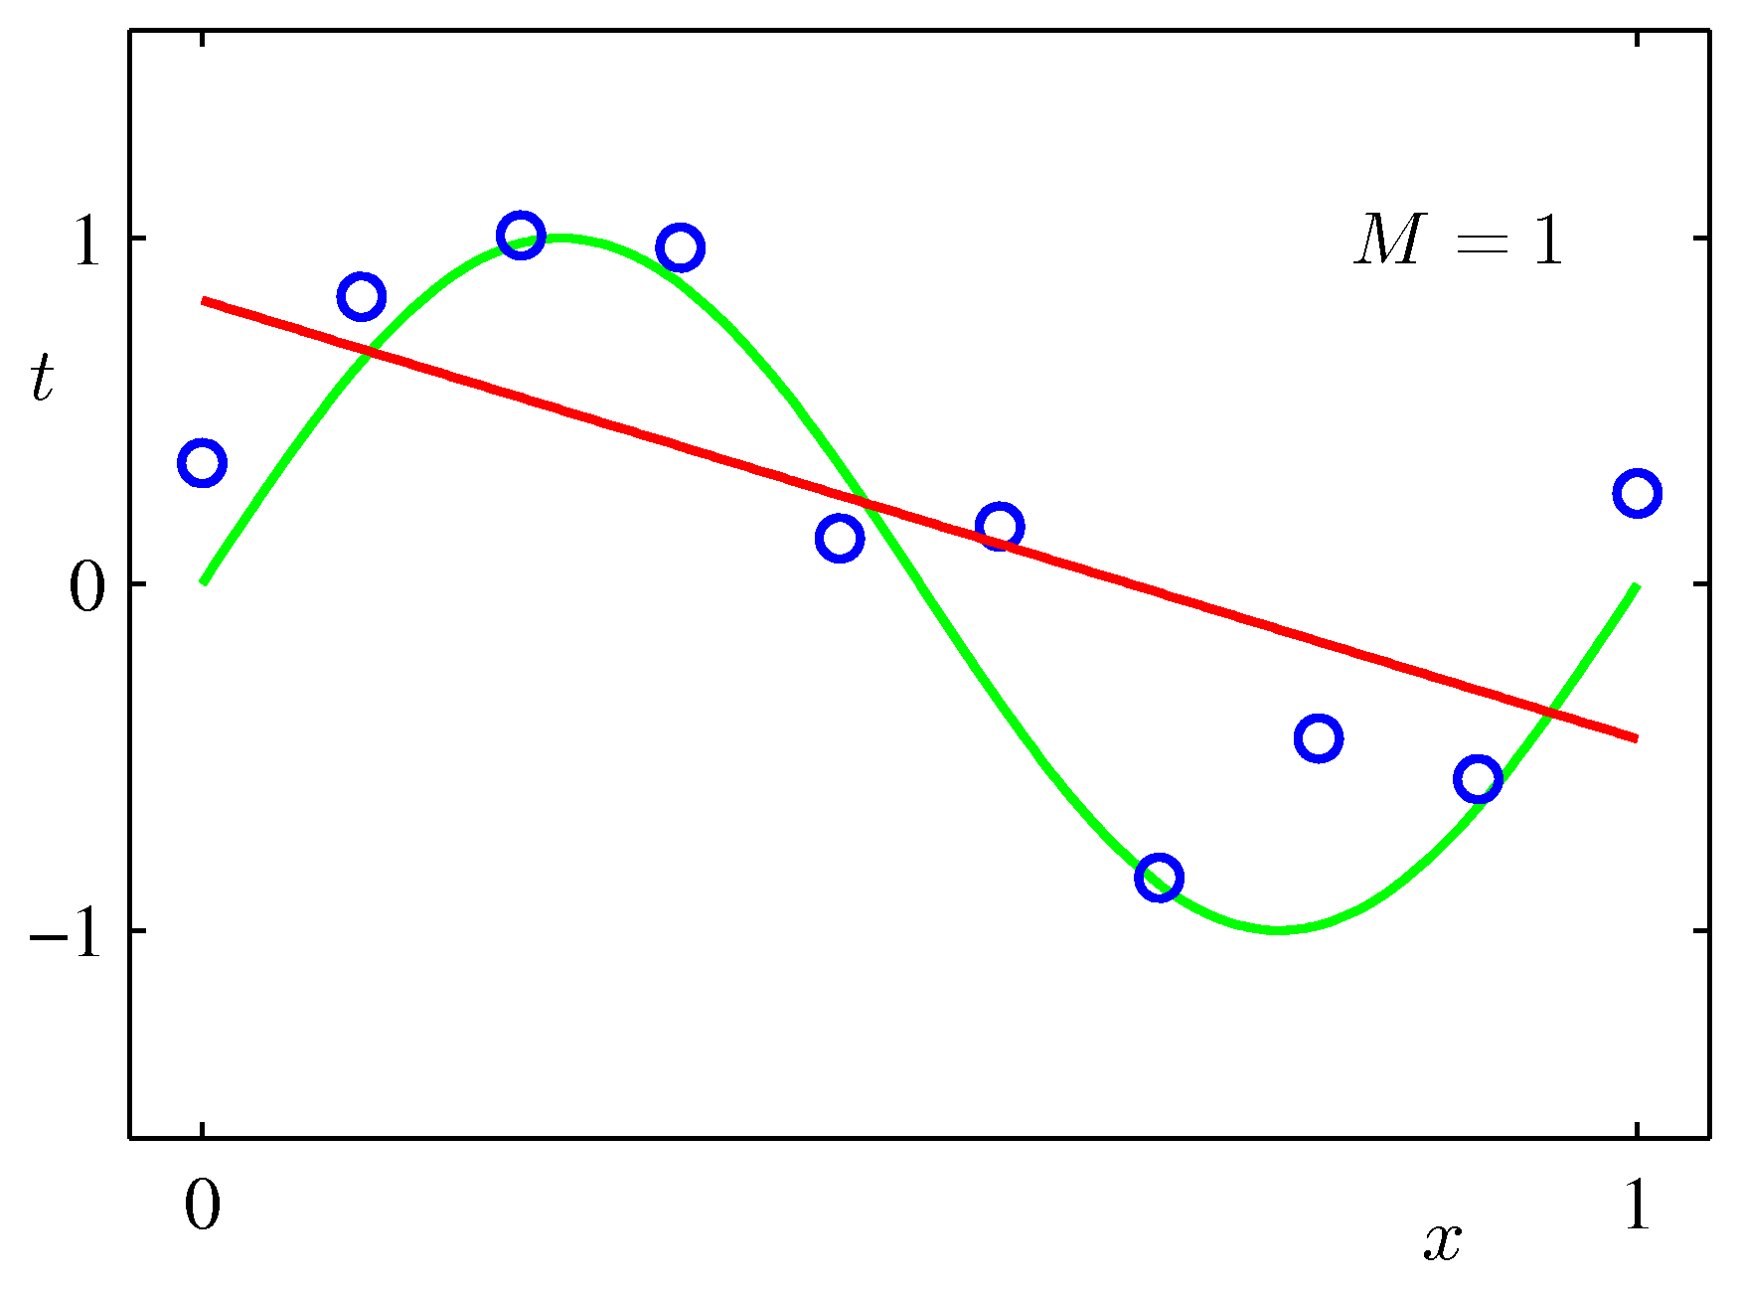
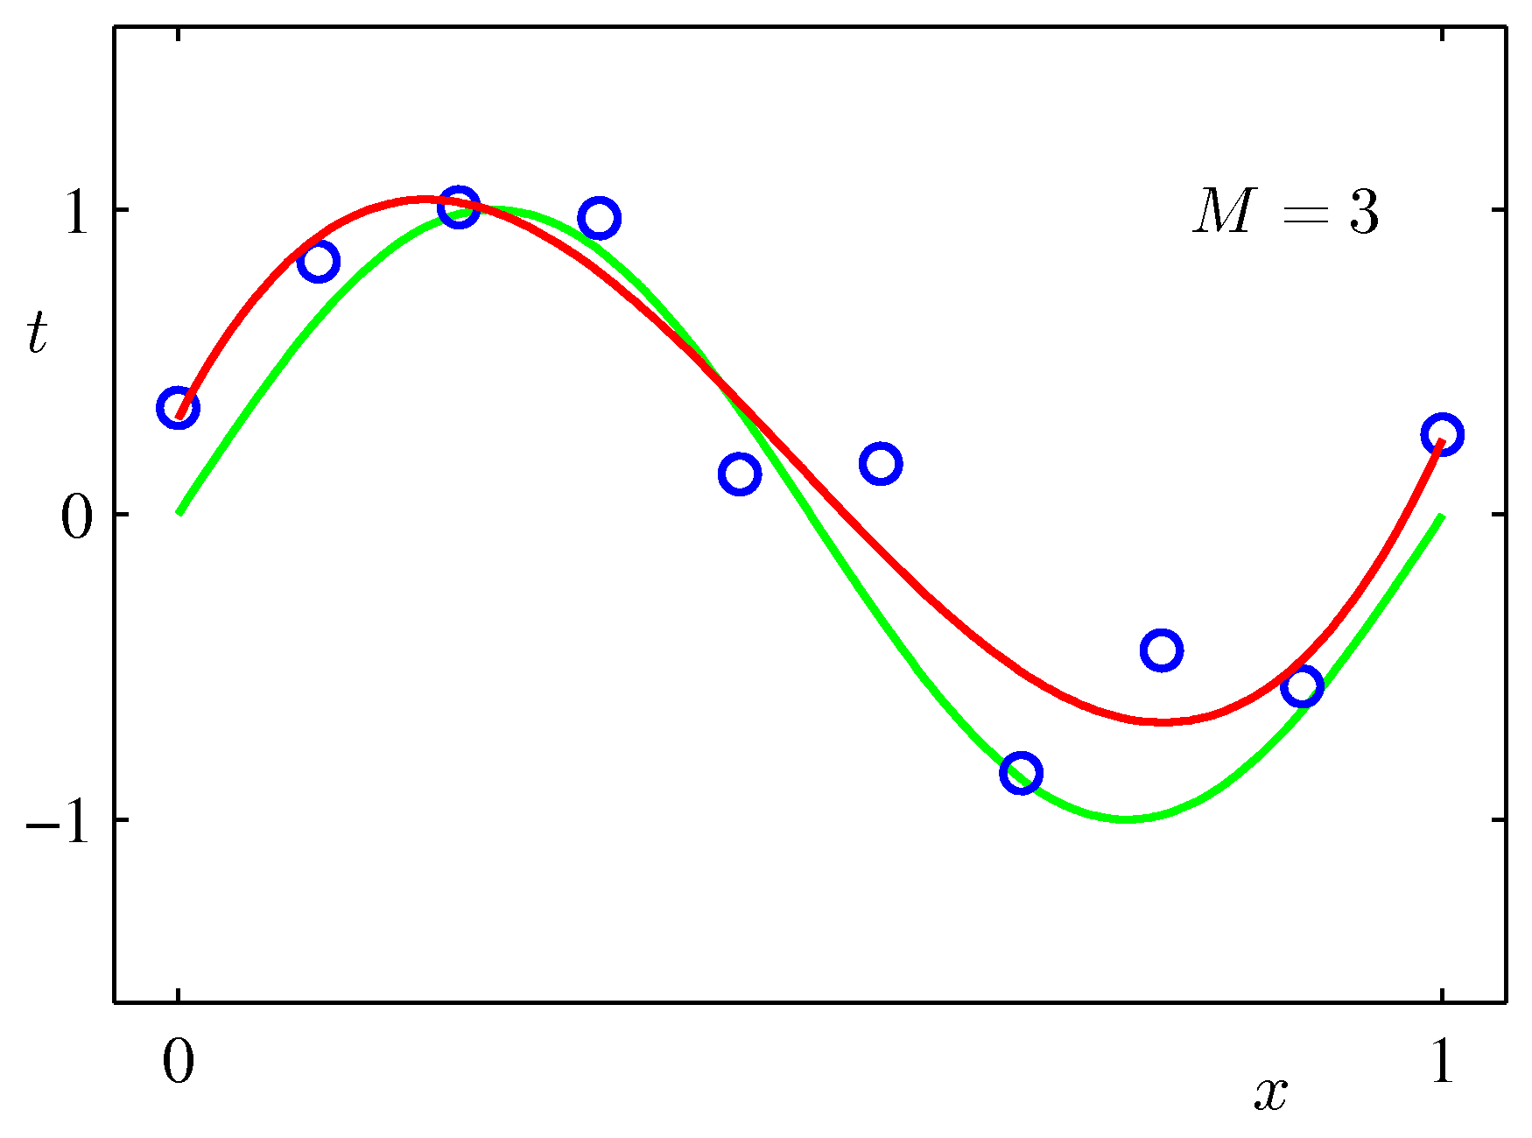
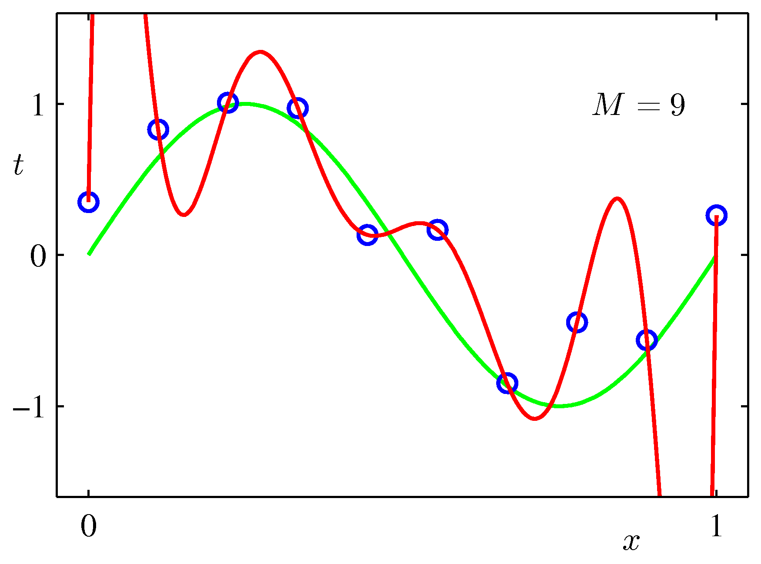

Toy Example
We need to choose the order M of the polynomial (model comparison or model selection)
$E\left(w^{∗}\right)$=0
Overfitting

Slide 10
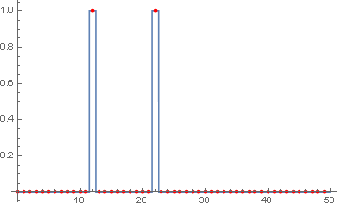
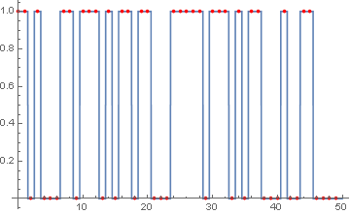
Experimento complejidad secuencia de bits
P=0.1
P=0.5
Para “emular” estas oscilaciones,
es necesario utilizar una base más grande

Slide 11
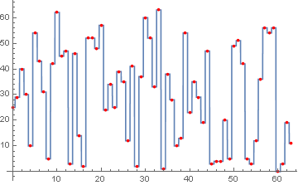
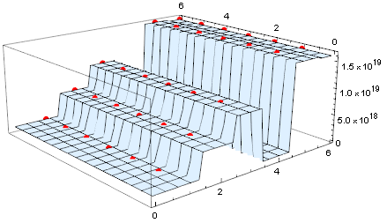
Experimento RBN
Dinámica
Estructura red
Base más grande$≈$ más tiempo de computo $≈$ programa más grande $≈$ mayor complejidad de kolmogorov

